Slide 1
Chapter 12 Graphical User Interface
FALL 2021

Slide 2
Concepts
Graphical User Interface
Presents a user-friendly mechanism for interacting with an application
Swing GUI components
Declared in package javax.swing
Most are pure Java components
Part of the Java Foundation Classes (JFC)
Abstract Window Toolkit (AWT)
Precursor to Swing
Declared in package java.awt
Does not provide consistent, cross-platform look-and-feel

Slide 3
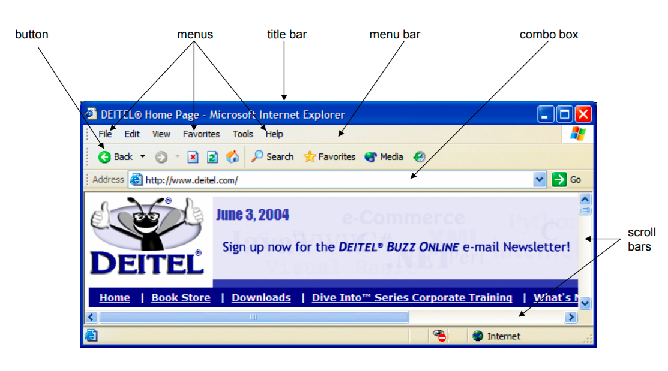

Slide 4
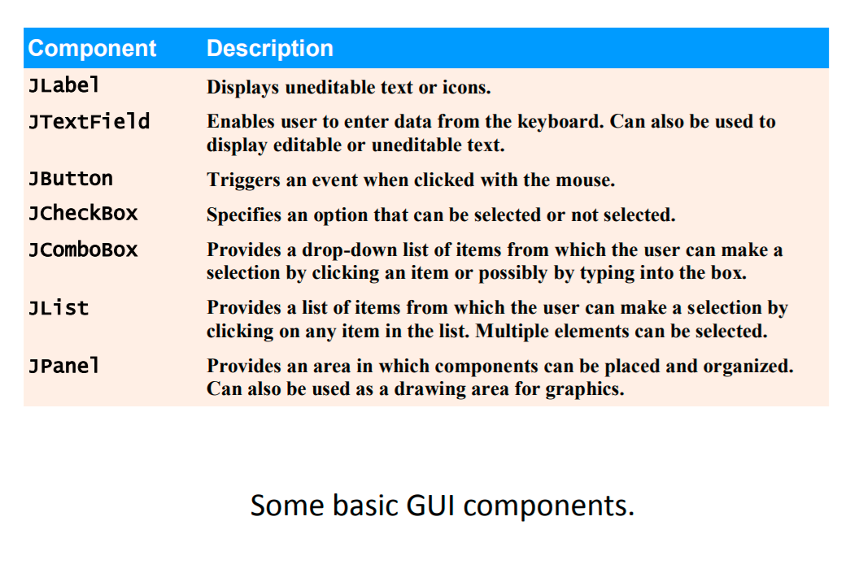

Slide 5
Container vs. Component
Class Component (package java.awt)
Declares many behaviors and attributes common to GUI components
Components are elementary GUI entities (Button, Label, …)
Class Container (package java.awt)
Subclass of Component
Organizes components, has an add(Component) behavior to add components to the container
Top-level Swing containers such as JFrame, JDialog, and JApplet are specialized components that provide a place for other Swing components to paint themselves.

Slide 6
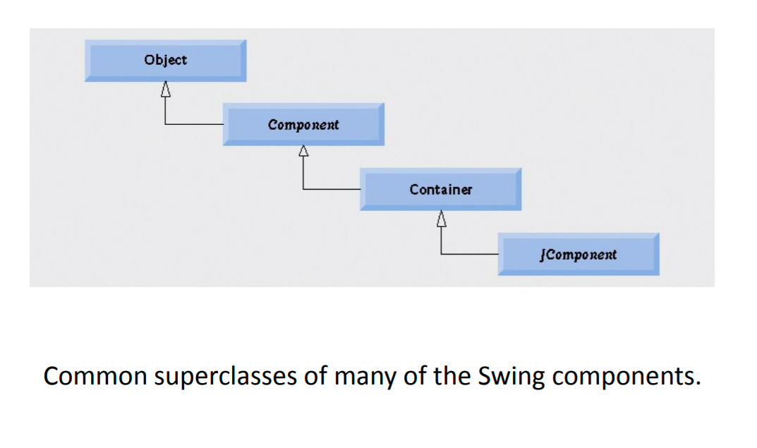

Slide 7
4 Main Steps in building a GUI (1)
A GUI program needs a top-level container, and is often written as a subclass of Frame
Create a class that extends the JFrame class or another container. This class will hold all the GUI components.
This class will inherit all the attributes and behaviors of a Frame such as the title bar and content pane.

Slide 8
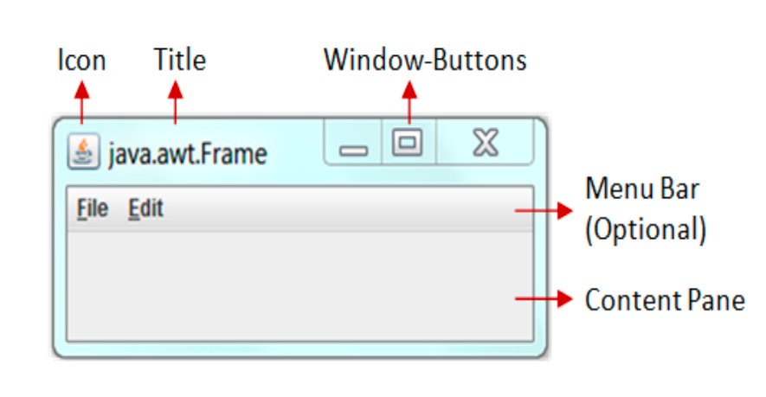
Pre-built Components of a Frame

Slide 9
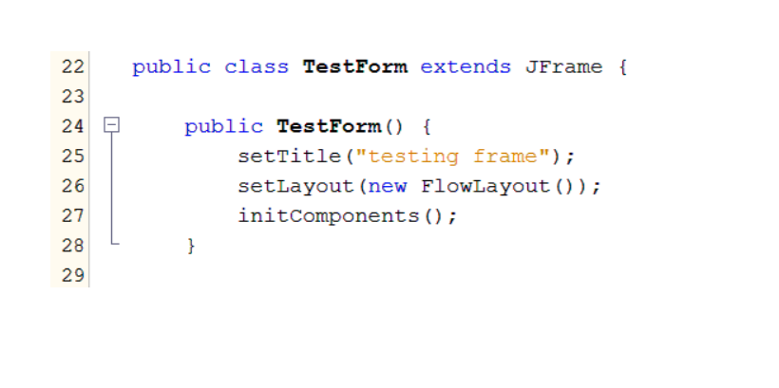
4 Main Steps in building a GUI (1)
Customize the properties of the frame, like the title, icon, and plan the overall layout of the application

Slide 10
4 Main Steps in Building GUI (2)
Create the components that make the application
Customize the properties of your components
Add the components to a container, either the top-level container or others like JPanel

Slide 11
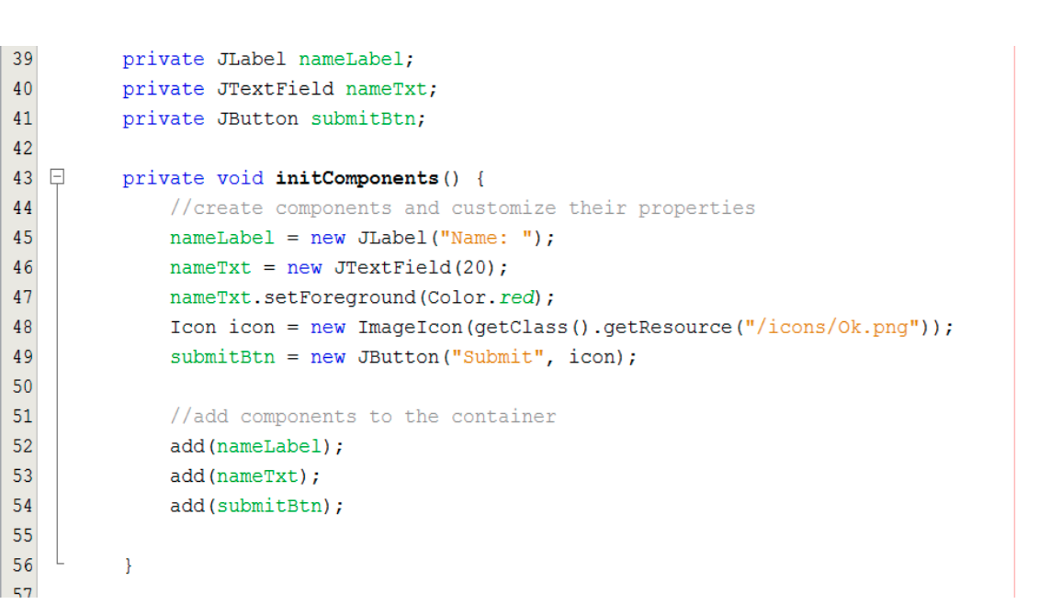

Slide 12
4 Main Steps to build a GUI (3)
GUIs are event-driven
A user interaction creates an event
Common events are clicking a button, typing in a text field, selecting an item from a menu, closing the window and moving the mouse.
You should program responses to the user actions or events

Slide 13
4 Main Steps in building a GUI (3)
Some concepts:
Event source is the component with which user interacts
Event object is created and contains information about the event that happened
Event listener is notified when an event happens
The event listener interface declares the method we wish to be invoked when an event happens. The method gets as input the event object created by the event source

Slide 14
4 Main Steps to build a GUI (3)
Several coding steps are required for an application to respond to events
Create an event handler class by implementing an appropriate event-listener interface
Register the event handler with the source components
Forgetting to register an event-handler object for a particular GUI component’s event type causes events of that type to be ignored.

Slide 15
Delegation Event Model
An event source produces event objects (when the user generates an event) and dispatches them to registered event listeners
Events are dispatched to only the event listeners that match the event type.

Slide 16
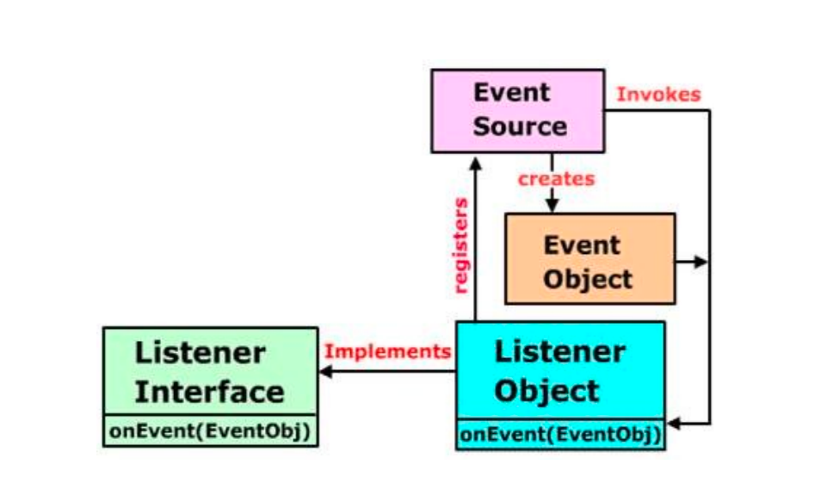
Delegation Event Model

Slide 17
Event Types (classes)
Event types
All are subclasses of AWTEvent
Some declared in package java.awt.event
Those specific to Swing components declared in javax.swing.event

Slide 18
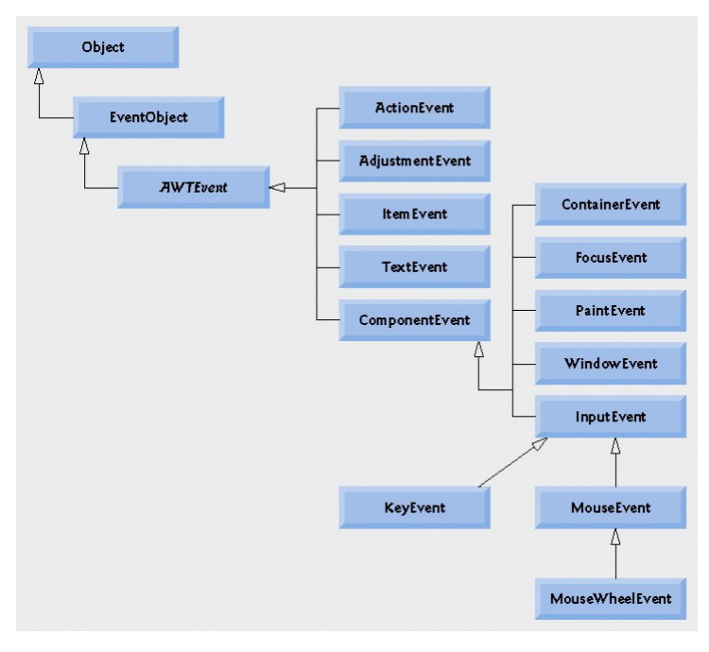

Slide 19
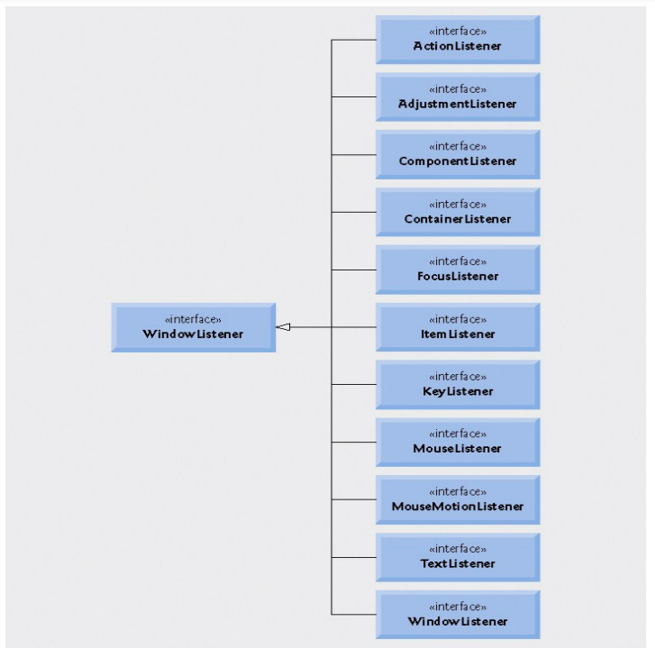

Slide 20
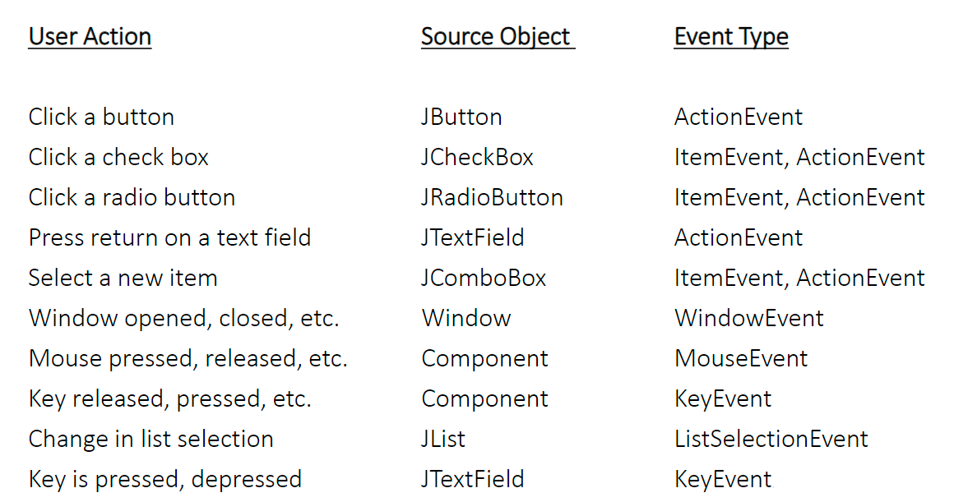
Mapping actions to event types

Slide 21
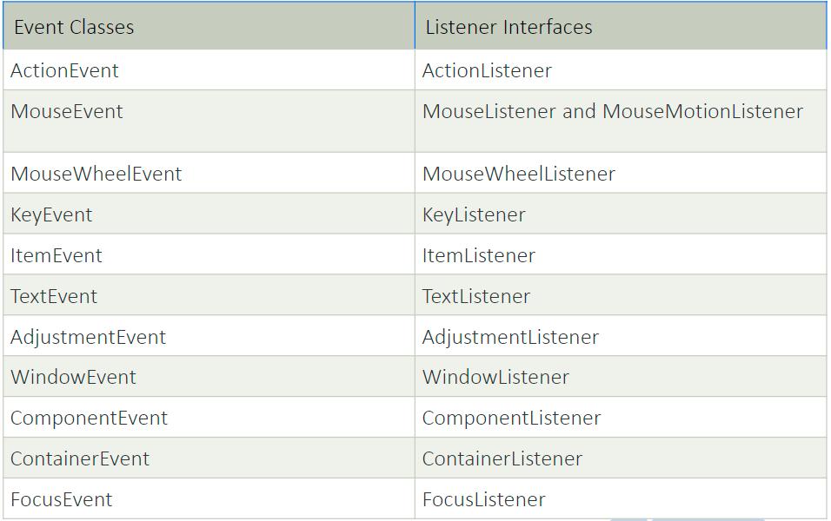
Event types and corresponding event listeners

Slide 22
Using a Nested Class to Implement an Event Handler
Top-level classes
Not declared within another class
Nested classes
Declared within another class
Non-static nested classes are called inner classes
An inner class is allowed to directly access its top-level class’s variables and methods, even if they are private.

Slide 23
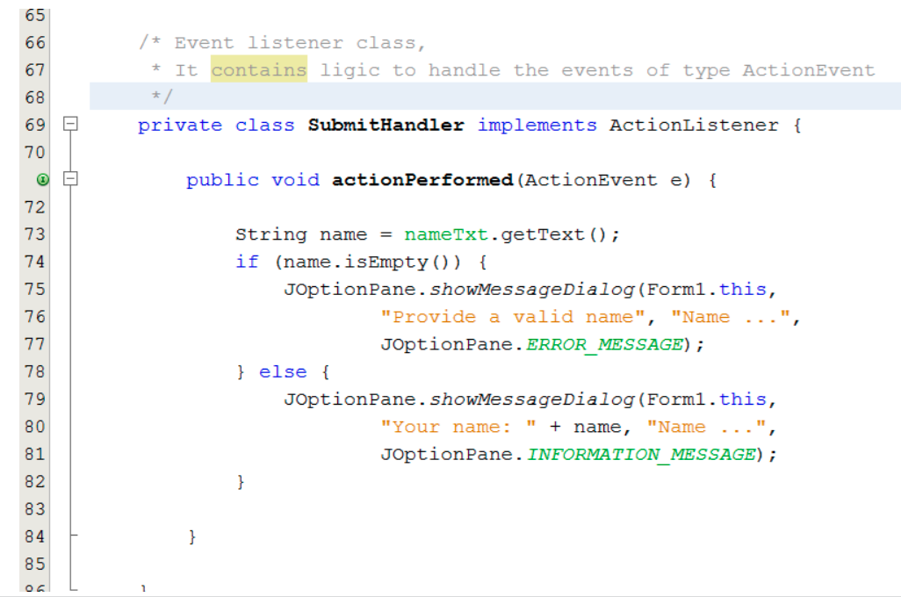
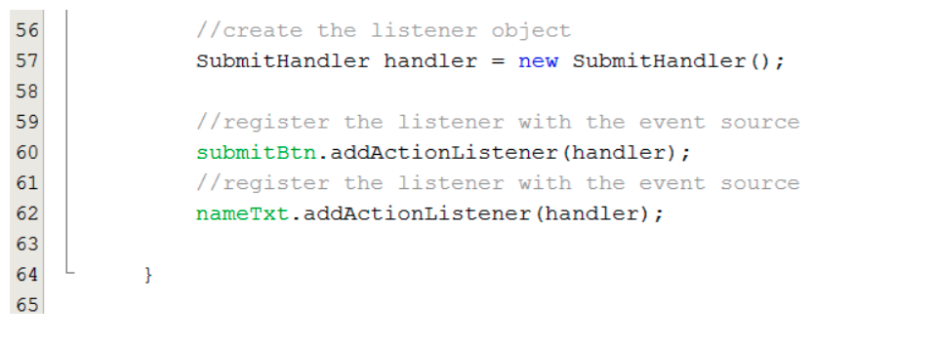

Slide 24
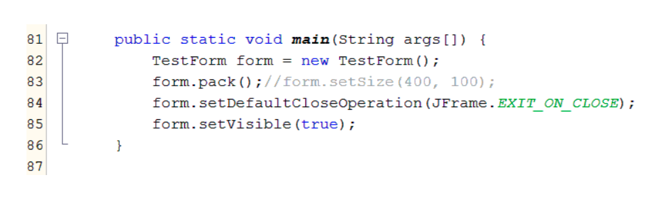
4 Main Steps to Build GUI (4)
Write the main method which will be the program’s entry point
In this method, create an instance of your frame, customize properties of you frame like the size.

Slide 25
Layout Managers
Layout managers
Provided to arrange GUI components in a container
Provide basic layout capabilities
Implement the interface LayoutManager
Each container can have only one layout manager. Separate containers in the same application can use different layout managers.

Slide 26
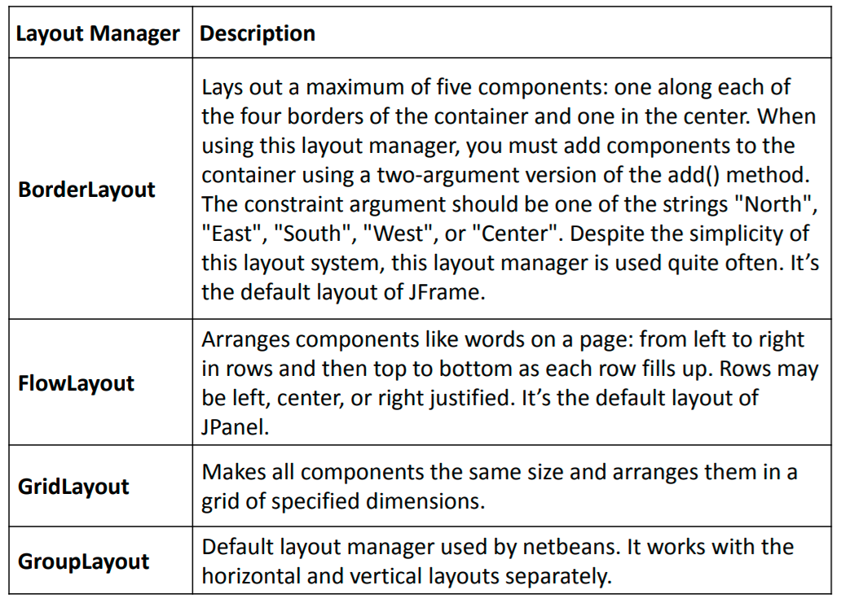

Slide 27
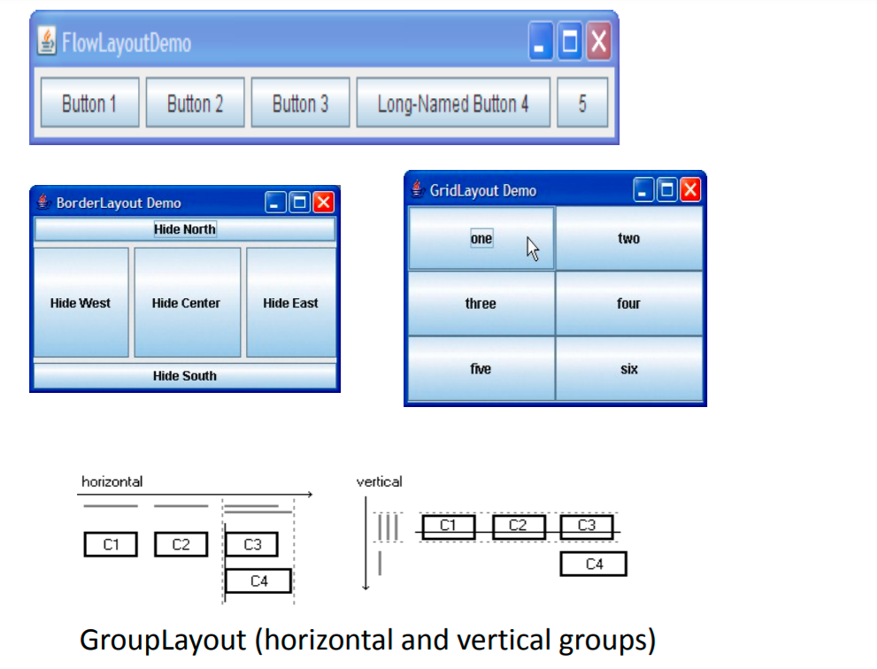

Slide 28
Pluggable Look and Feel
”Look” refers to the appearance of the GUI widgets (more formally, JComponents) and “feel” refers to the way the widgets behave.
Sun’s JRE provides the following L&Fs:
CrossPlatformLookAndFeel: the Java L&F (also called “Metal” that looks the same on all platforms. It is part of the Java API and is the default that will be used if you do nothing in your code to set a different L&F.
SystemLookAndFeel: here, the application uses the L&F that is native to the system it is running one. The system L&F is determined at runtime, where the application asks the system to return the name if the appropriate L&F.

Slide 29
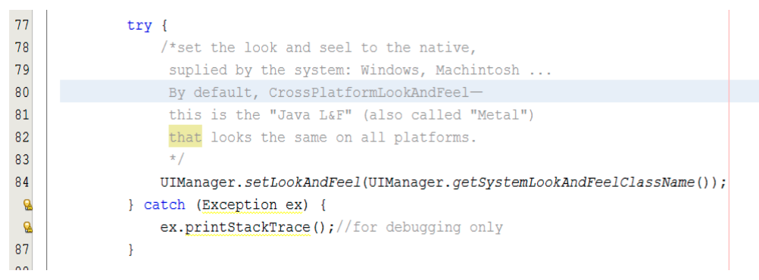

Slide 30
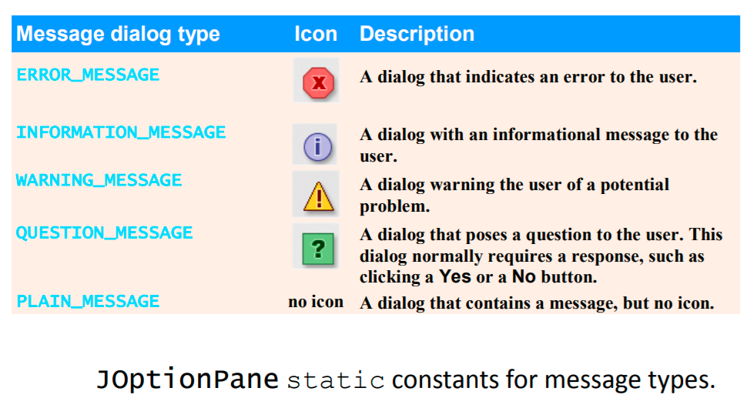
Dialogs: JOptionPane

Slide 31
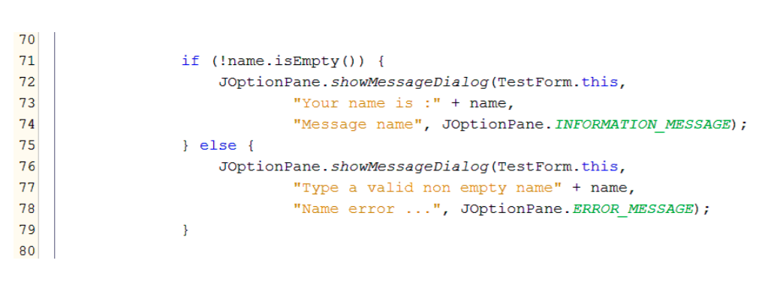

Slide 32
Swing Model-and-View Pattern
Views – it is possible to manipulate the state of a GUI control through top-level methods on the component.
Data Models – are interfaces that represent some quantifiable data that has meaning primarily in the context of the application, such as the value of a cell in a table or the items displayed in a list.
The Model-and-View pattern provides clean separation between the application data/logic and the GUI.

Slide 33
List
List
Displays a series of items from which the user may select one or more items
Implements by class JList
Allows for single-selection lists or multiple-selection lists, both single interval and multiple interval
A ListSelectionEvent occurs when an item is selected
Handled by a ListSelectionListener

Slide 34
Example
For example, JList’s model interface is ListModel
Which provides both DefaultListModel and AbstractListModel classes to help the developer in building a list model

Slide 35
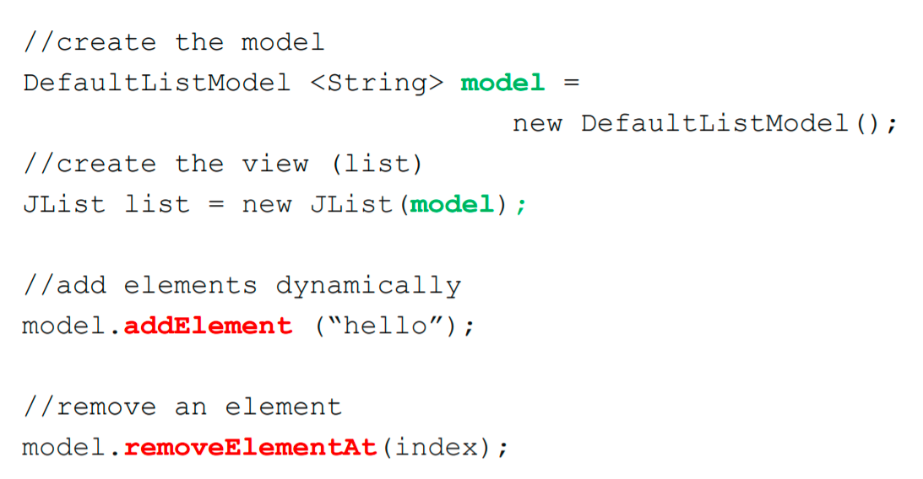
JList Model Example

Slide 36
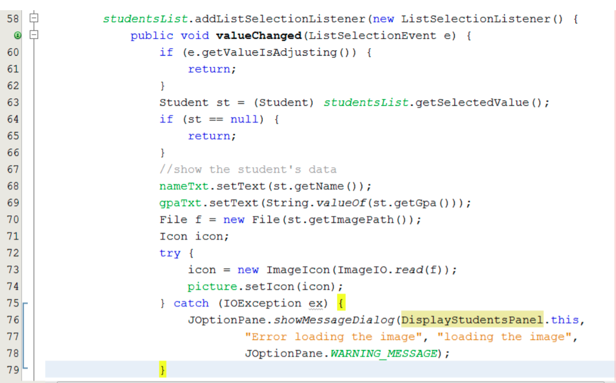

Slide 37
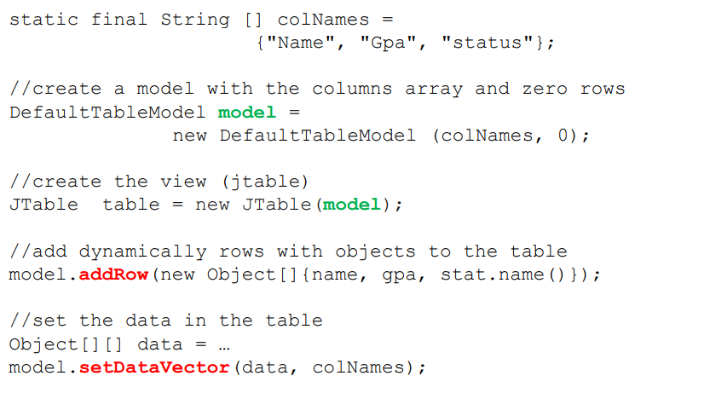
JTable Model Example

Slide 38
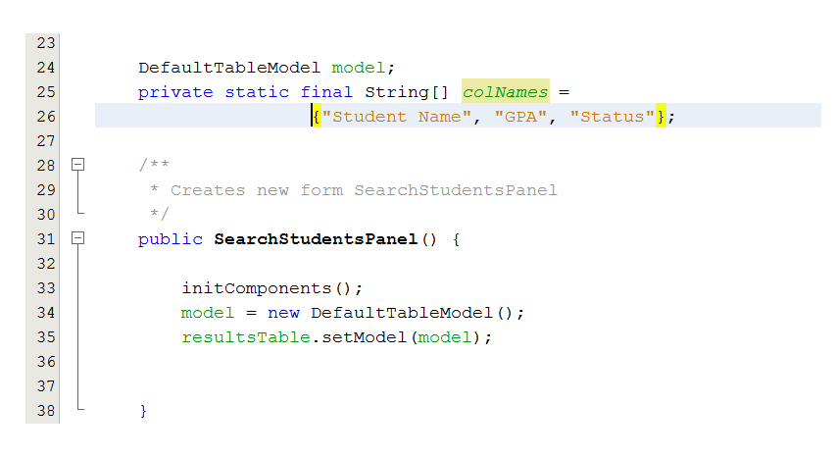

Slide 39
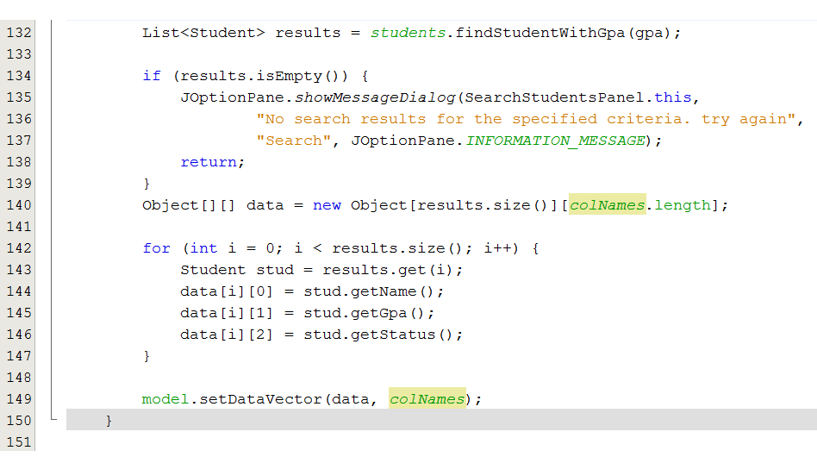

Slide 40
How to arrange GUI code into several containers
With the JTabbedPane class, you can have several components, such as panels, share the same space
The user chooses which component to view by selecting the tab corresponding to the desired component

Slide 41
How to arrange GUI code into several containers
Arrange GUI components for the different views into layers, each layer corresponds to a panel
Create a customized class that extends JPanel
Then, add instances of the panels to a JTabbedPane container
One panel visible at a time
Access aech panel via a tab

Slide 42
